Slide 1
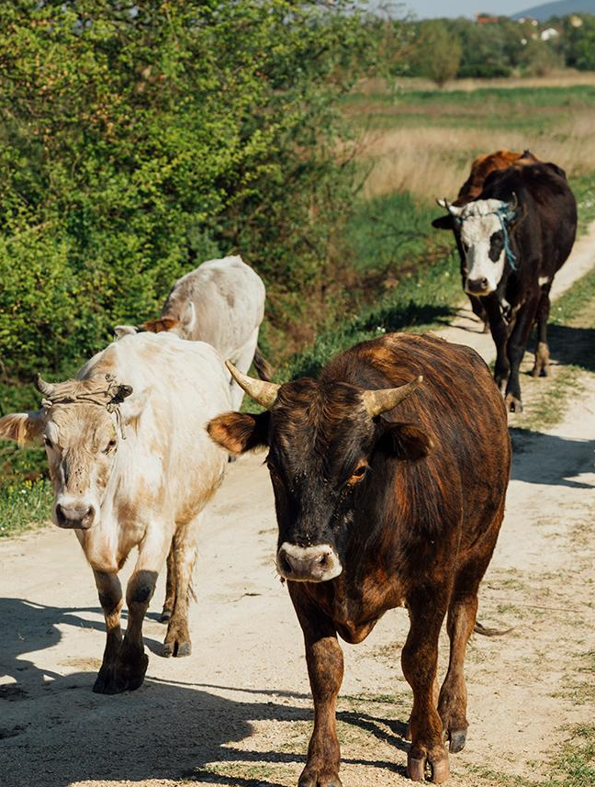
COUNTRY DELIGHT DAIRY SALES AND INVENTORY PERFORMANCE
Submitted by,
ANN MARIYA JOSE

Slide 2
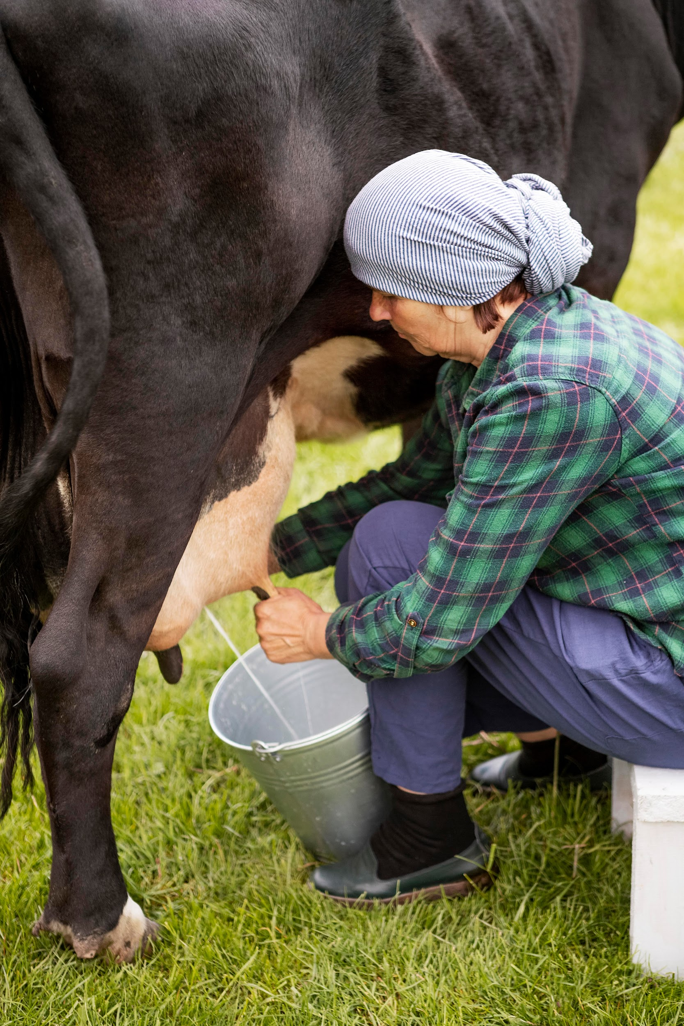
INTRODUCTION
Covers dairy operations, sales, and inventory across India.
Includes farm characteristics and product details
Provides daily sales and inventory tracking
Records production and expiry dates
Supports sales, demand, spoilage, and shelf-life analysis

Slide 3
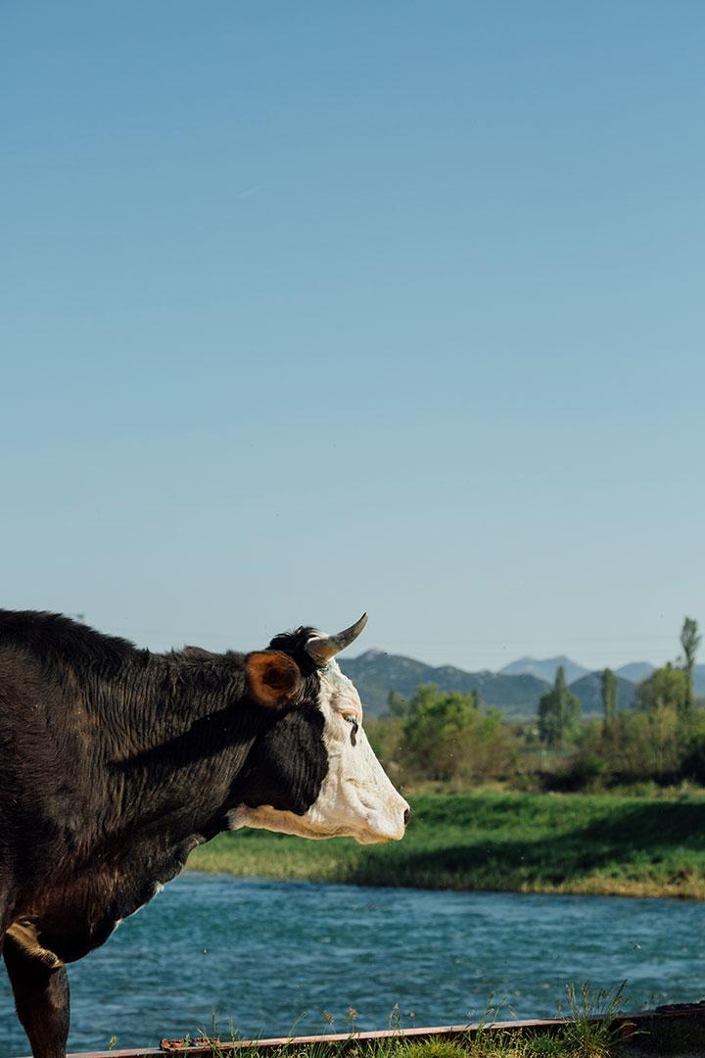
OBJECTIVES
Analyse overall sales performance.
Optimize inventory levels.
Improve reorder planning.
Understand product profitability drivers.
Monitor farm and location efficiency.

Slide 4
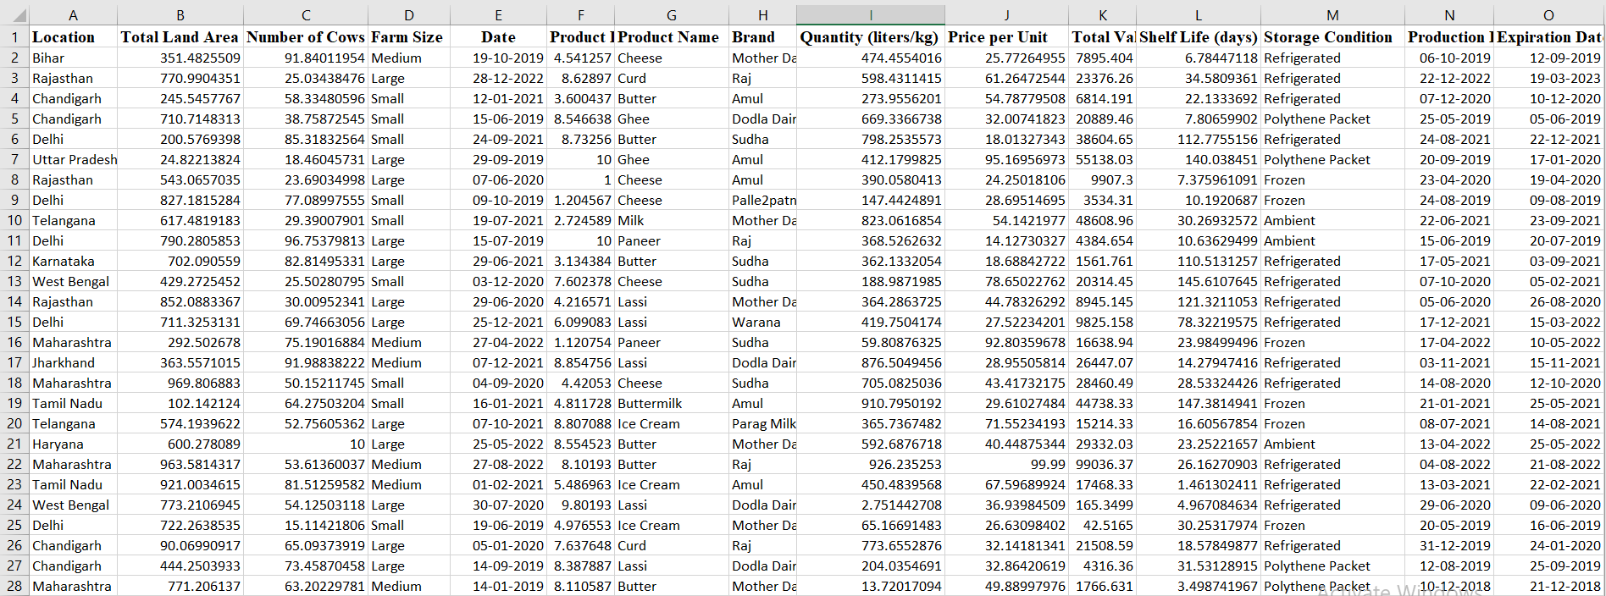
DATASET
1
2
4
5
6

Slide 5
DATASET STRUCTURE
Rows – 122,983
Columns – 23
Location: The geographical region of the dairy farm.
Total Land Area (acres): The size of the dairy farm.
Number of Cows: Total number of cows at the farm.
Farm Size: Categorization of farms as Small, Medium, or Large.
Date: Date of data collection.
Product Name: Type of dairy product.
Brand: The brand associated with the dairy product.
Quantity (liters/kg): The total quantity available.

Slide 6
Price per Unit: The unit price of the product.
Total Value: The total value based on available quantity.
Shelf Life (days): The product's expiration period.
Storage Condition: Storage requirements.
Production Date: Manufacturing date of the product.
Expiration Date: Date when the product expires.
Quantity Sold (liters/kg): The amount of product sold.
Price per Unit (sold): The selling price per unit.
Approx. Total Revenue (INR): Estimated revenue from sales.
Customer Location: The buyer's location.
Sales Channel: Mode of sale (Retail, Wholesale, or Online).
Quantity in Stock (liters/kg): Remaining stock levels.
Minimum Stock Threshold (liters/kg): The minimum required stock before restocking.
Reorder Quantity (liters/kg): Suggested reorder amount to maintain inventory.

Slide 7
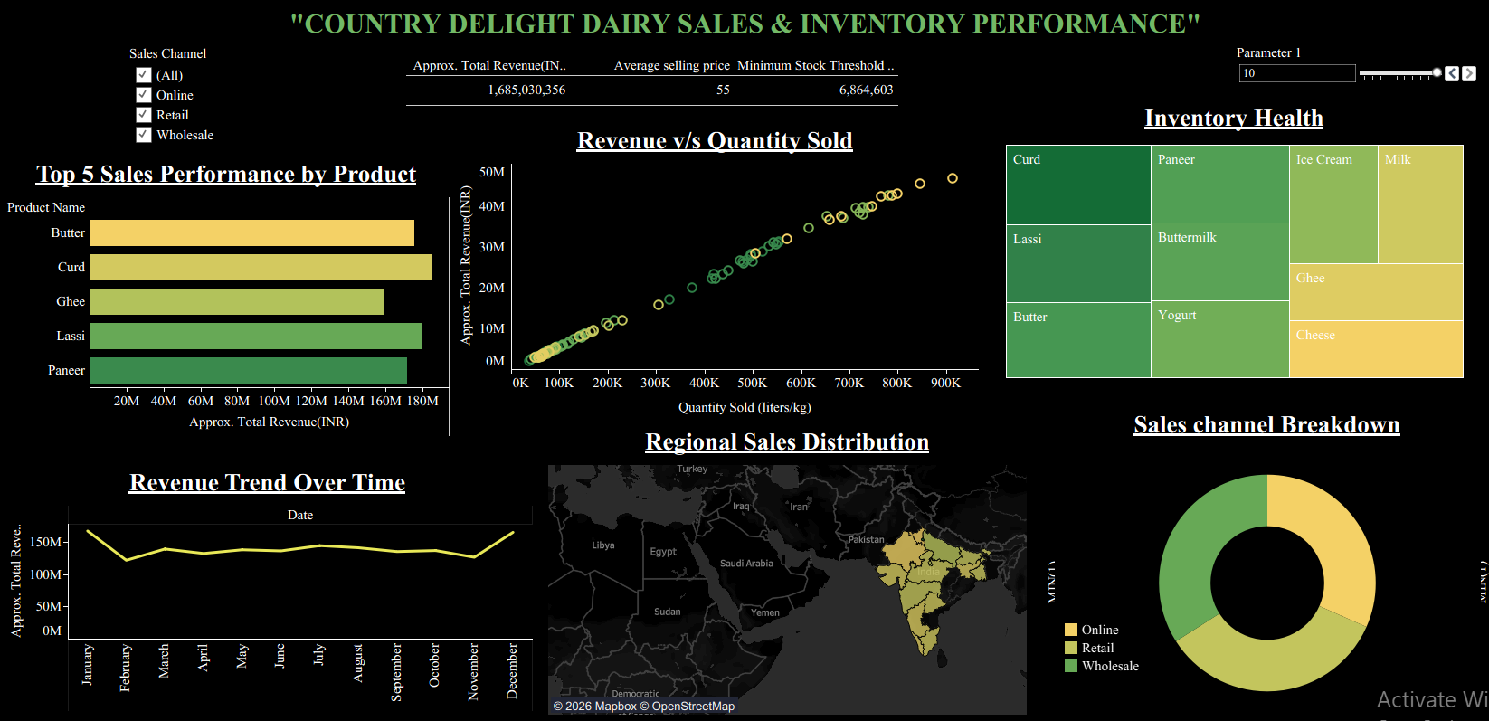
DASHBOARD

Slide 8
CRITERIAS USED
Sales Performance by Product – Bar chart
Revenue Trend over time – Line chart
Regional Sales Distribution – Map
Inventory Health – Treemap
Sales channel Breakdown – Donut chart
KPIs – Approx. Total Revenue, Average selling price, Minimum Stock Threshold
Filter – Sales channel

Slide 9
CONCLUSION
Total revenue of approximately 1.68 billion INR
Curd, Lassi, and Butter are the top revenue-generating products
Amul and Mother Dairy are the leading brands
Uttar Pradesh and Bihar are the highest-performing regions
Sales are balanced across retail, wholesale, and online channels
21.16% of inventory is below minimum stock levels

Slide 10
SUGGESTIONS
Sales & Profitability Analysis: Identify top-performing brands and products by region to better tailor marketing and sales efforts.
Shelf-Life & Wastage Audit: Use production and expiration dates to implement "First-Expired-First-Out" (FEFO) strategies or dynamic discounting to minimize spoilage.
Inventory Optimization: Compare current stock against minimum thresholds to prevent stock outs and reduce the holding costs of overstocked items.

Slide 11
REFERENCES
https://www.kaggle.com/datasets/shrutithakur13/dairy-sales-and-inventory-data

Slide 12
THANK YOU

